Slide 1
On the Key Problems of GANs
Speaker: Zhiming Zhou
Notes:
此页可以删除

Slide 2
About Me
Education:
  Ph.D. candidate in Computer Science, Shanghai Jiao Tong University.
  Bachelor’s degree obtained from ACM class, Shanghai Jiao Tong University.
Research Interest:
  Currently mainly focus on GANs. (2017 ~ now)
    Also work on related problems, including optimization, optimal transport, etc.
  Used to work on Computer Graphics. (2014 ~ 2016)
    Surface reflectance acquisition, related to sparsity, low-rank, and deblurring.
  Plan to extend and gradually move to Deep Learning Theory.

Slide 3
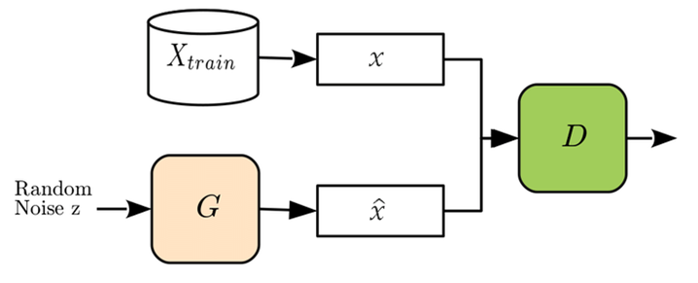
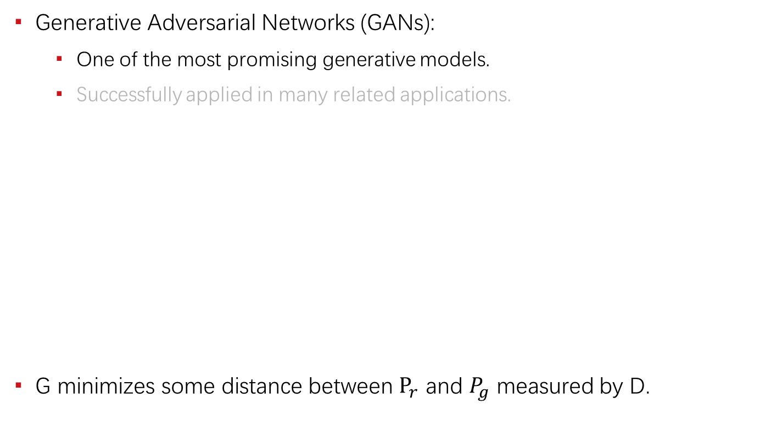
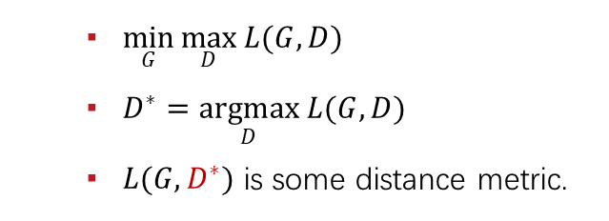
Introduction
Generative Adversarial Networks (GANs):
  One of the most promising generative models.
  Successfully applied in many related applications.
G minimizes some distance between $P_{r}$ and $P_{g}$ measured by D.
  $\min_{G}{\max_{D}{L(G, D)}}$
  $D^{∗}=\underset{D}{argmax}{L(G, D)}$
  $L(G, D^{∗})$ is some distance metric.

Slide 4
Key Problems
Training issues
  Instability
  Unreachable optimum
Sample quality issues
  Complex dataset
  Latent space
Generalization issue
Symptoms:
  Hyperparameter sensitive
  Mode collapse
  Training failure (diverge / crash)
Related work:
  Lipschitz GANs. (ICML, 2019)

Slide 5
Key Problems
Training issues
  Instability
  Unreachable optimum
Sample quality issues
  Complex dataset
  Latent space
Generalization issue
Symptoms:
  𝑃_{𝑔}≠𝑃_{𝑟}
  𝑓≠𝑓∗ (i.e. , D≠𝐷∗)
Related work:
  AdaShift. (ICLR, 2019)

Slide 6
Key Problems
Training issues
  Instability
  Unreachable optimum
Sample quality issues
  Complex dataset
  Latent space
Generalization issue
Symptoms:
  High quality on simple dataset.
  Hard to model complex dataset.
Related work:
  AM-GANs. (ICLR, 2018)

Slide 7
Training Instability
Mainly from Lipschitz GANs. (ICML, 2019)

Slide 8
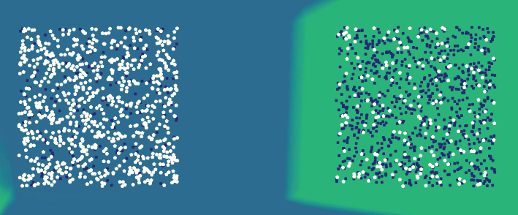
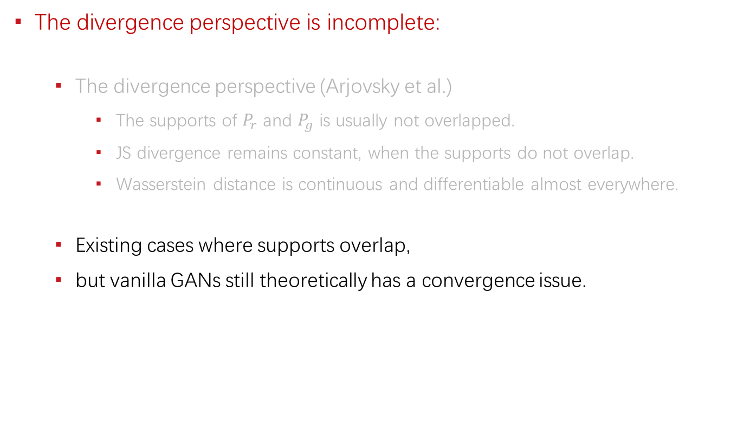
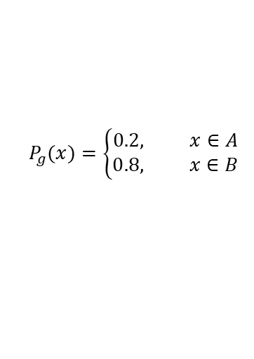
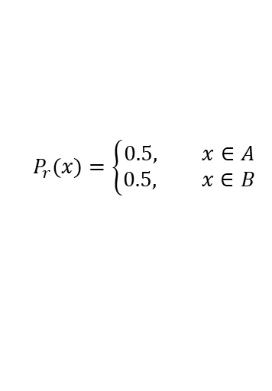
The Essence of Convergence
The divergence perspective is incomplete:
  The divergence perspective (Arjovsky et al.)
    The supports of $P_{r}$ and $P_{g}$ is usually not overlapped.
    JS divergence remains constant, when the supports do not overlap.
    Wasserstein distance is continuous and differentiable almost everywhere.
  Existing cases where supports overlap,
  but vanilla GANs still theoretically has a convergence issue.
$$P_{g}(x)=\left\{\begin{aligned}0.2, x∈A \\ 0.8, x∈B\end{aligned}\right.$$
$$P_{r}(x)=\left\{\begin{aligned}0.5, x∈A \\ 0.5, x∈B\end{aligned}\right.$$

Slide 9
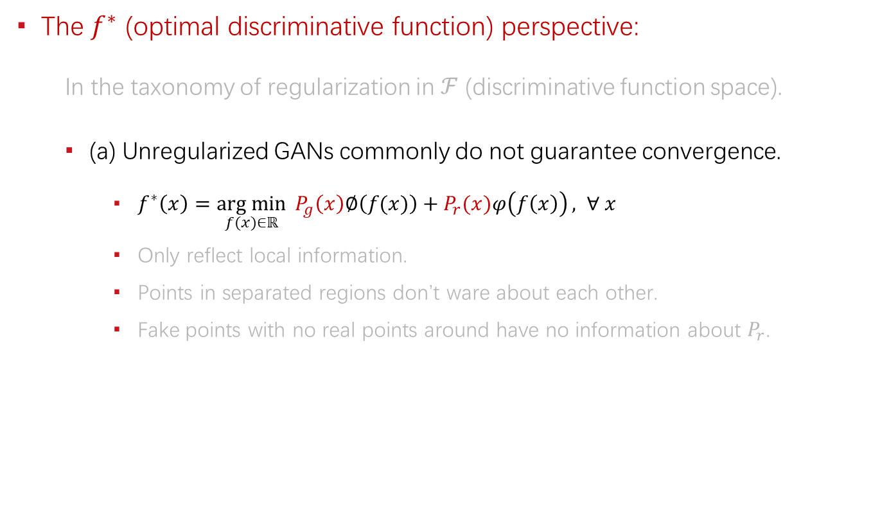
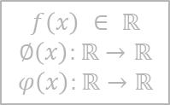
The Essence of Convergence
The $f^{∗}$ (optimal discriminative function) perspective:
  In the taxonomy of regularization in $ℱ$ (discriminative function space).
  (a) Unregularized GANs commonly do not guarantee convergence.
    $f^{∗}\left(x\right)=\underset{f(x)∈ℝ}{arg min}{ P_{g}\left(x\right)∅\left(f(x)\right)+P_{r}(x)φ\left(f\left(x\right)\right)}, ∀ x$
    Only reflect local information.
    Points in separated regions don’t ware about each other.
    Fake points with no real points around have no information about $P_{r}$.
$$f\left(x\right) ∈ ℝ$$
$$∅\left(x\right):ℝ→ℝ$$
$$φ\left(x\right):ℝ→ℝ$$
$$P_{g}(x)=\left\{\begin{aligned}0.2, x∈A \\ 0.8, x∈B\end{aligned}\right.$$
$$P_{r}(x)=\left\{\begin{aligned}0.5, x∈A \\ 0.5, x∈B\end{aligned}\right.$$
Including vanilla GANs, Least-squares GANs, f-GANs, etc.

Slide 10
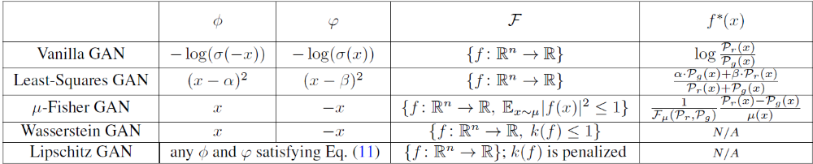


Generalized Formulation of GANs
$$\min_{G}{\max_{D}{L(G, D)}}$$
$$\min_{g}{\max_{f}}𝔼_{z\sim P_{z}}∅\left(f\left(g(z)\right)\right)+𝔼_{x\sim P_{r}}φ\left(f\left(x\right)\right)$$
$f$ is another notation for $D$ and $f^{∗}$ is the optimal $f$.

Slide 11
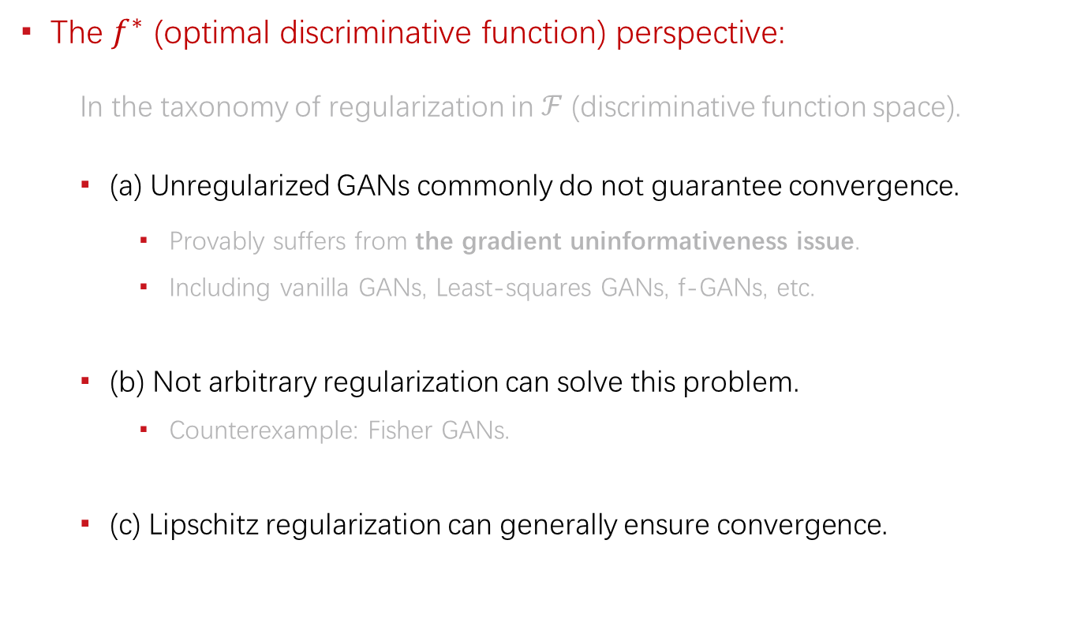
The Essence of Convergence
The $f^{∗}$ (optimal discriminative function) perspective:
  In the taxonomy of regularization in $ℱ$ (discriminative function space).
  (a) Unregularized GANs commonly do not guarantee convergence.
    Provably suffers from the gradient uninformativeness issue.
    Including vanilla GANs, Least-squares GANs, f-GANs, etc.
  (b) Not arbitrary regularization can solve this problem.
    Counterexample: Fisher GANs.
  (c) Lipschitz regularization can generally ensure convergence.

Slide 12
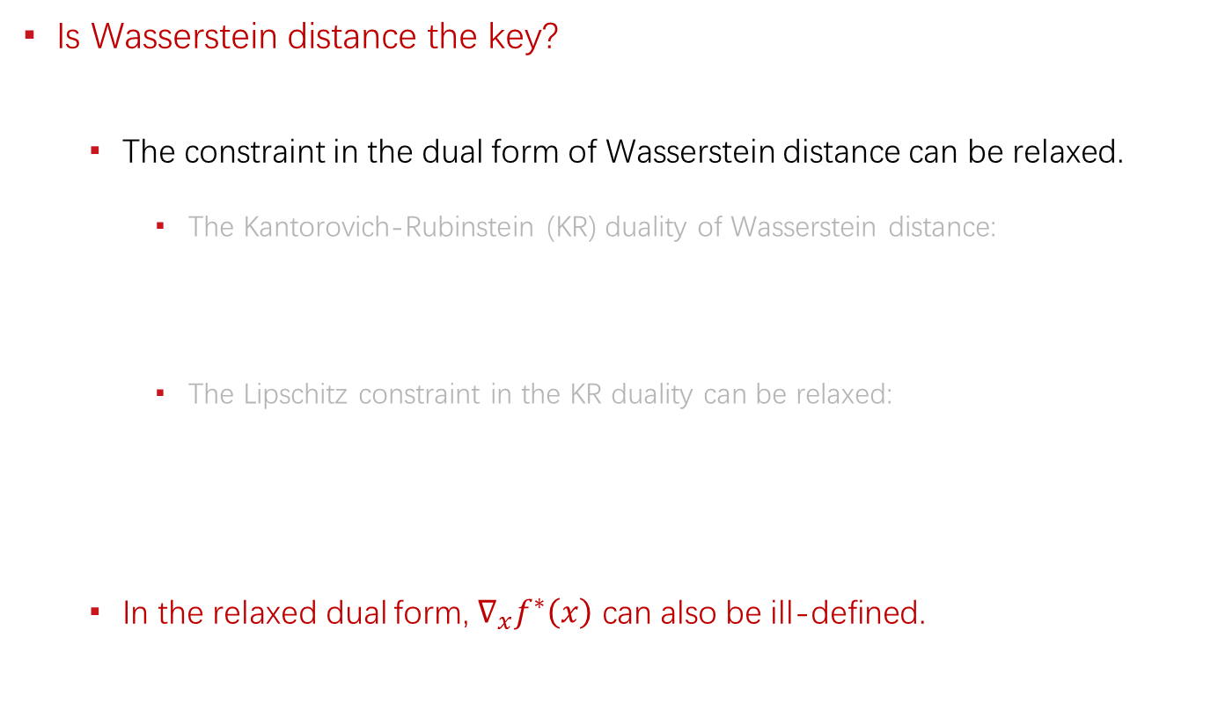
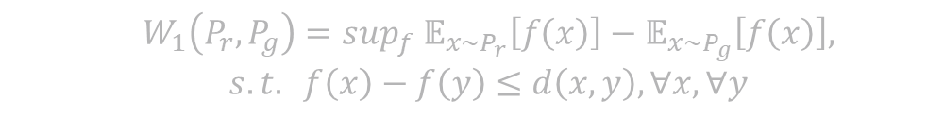

The Essence of Convergence
Is Wasserstein distance the key?
  The constraint in the dual form of Wasserstein distance can be relaxed.
    The Kantorovich-Rubinstein (KR) duality of Wasserstein distance:
    The Lipschitz constraint in the KR duality can be relaxed:
  In the relaxed dual form, $∇_{x}f^{∗}\left(x\right)$ can also be ill-defined.
  $$W_{1}\left(P_{r}, P_{g}\right)=\sup_{f} 𝔼_{x\sim P_{r}}\left[f\left(x\right)\right]−𝔼_{x\sim P_{g}}\left[f\left(x\right)\right],$$
  $$s.t. f\left(x\right)−f\left(y\right)≤d\left(x,y\right), ∀x, ∀y$$
  $$W_{1}\left(P_{r}, P_{g}\right)=\sup_{f} 𝔼_{x\sim P_{r}}\left[f\left(x\right)\right]−𝔼_{x\sim P_{g}}\left[f\left(x\right)\right],$$
  $$s.t. f\left(x\right)−f\left(y\right)≤d\left(x,y\right), ∀x∈supp(P_{r},) ∀y∈supp(P_{g})$$

Slide 13
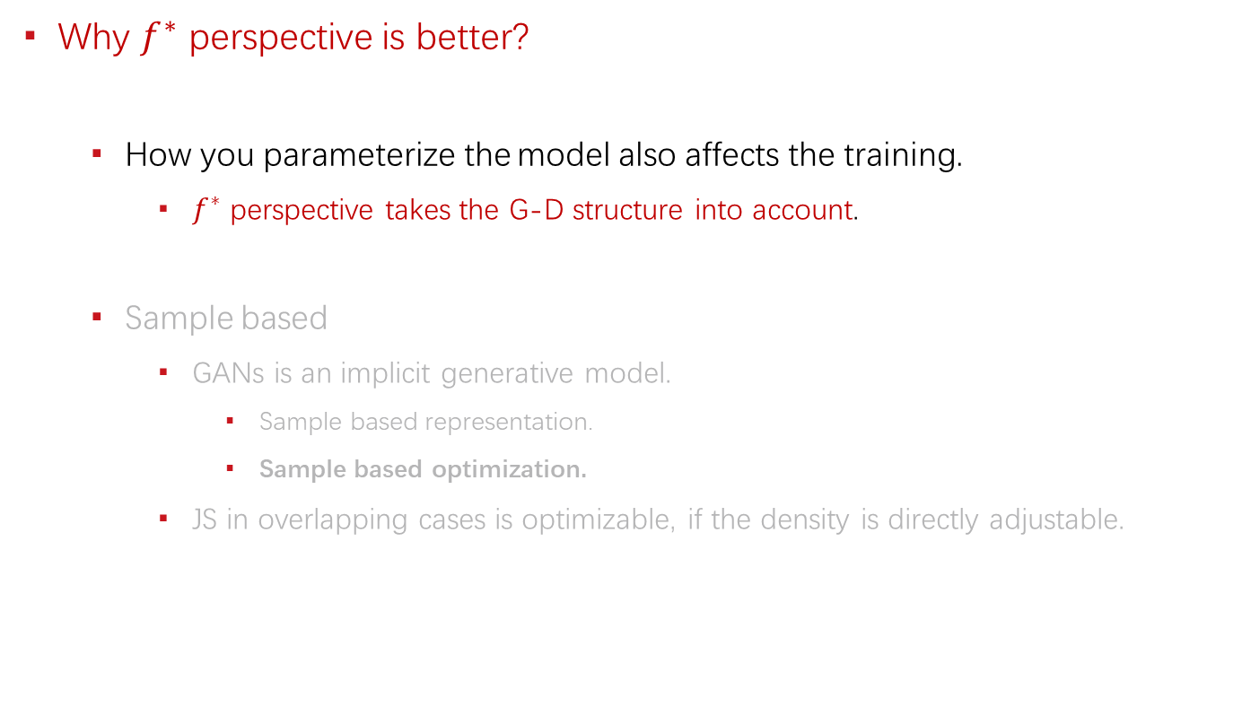
The Essence of Convergence
Why $f^{∗}$ perspective is better?
  How you parameterize the model also affects the training.
    $f^{∗}$ perspective takes the G-D structure into account.
  Sample based
    GANs is an implicit generative model.
      Sample based representation.
      Sample based optimization.
    JS in overlapping cases is optimizable, if the density is directly adjustable.

Slide 14
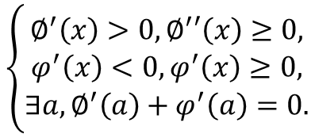
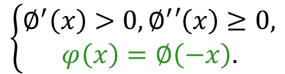

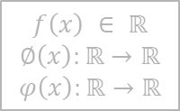
Lipschitz GANs
General formulation:
As long as, it satisfies:
Any increasing function with no decreasing derivative derives a LGANs.
The Lipschitz constant of $f$.
$$𝔼_{z\sim P_{z}}∅\left(f\left(g(z)\right)\right)+𝔼_{x\sim P_{r}}φ\left(f\left(x\right)\right)+λ∙{k(f)}^{2}$$
$$f\left(x\right) ∈ ℝ$$
$$∅\left(x\right):ℝ→ℝ$$
$$φ\left(x\right):ℝ→ℝ$$
The generalized formulation of GANs.
$$\left\{\begin{aligned}∅^{′}\left(x\right)>0,∅^{′}′\left(x\right)≥0, \\ φ^{′}\left(x\right)<0,φ^{′}\left(x\right)≥0, \\ ∃a,∅^{′}\left(a\right)+φ^{′}\left(a\right)=0.\end{aligned}\right.$$
or simplified as:
(more restrictive)
$$\left\{\begin{aligned}∅^{′}\left(x\right)>0,∅^{′}′\left(x\right)≥0, \\ φ\left(x\right)=∅\left(−x\right).\end{aligned}\right.$$

Slide 15
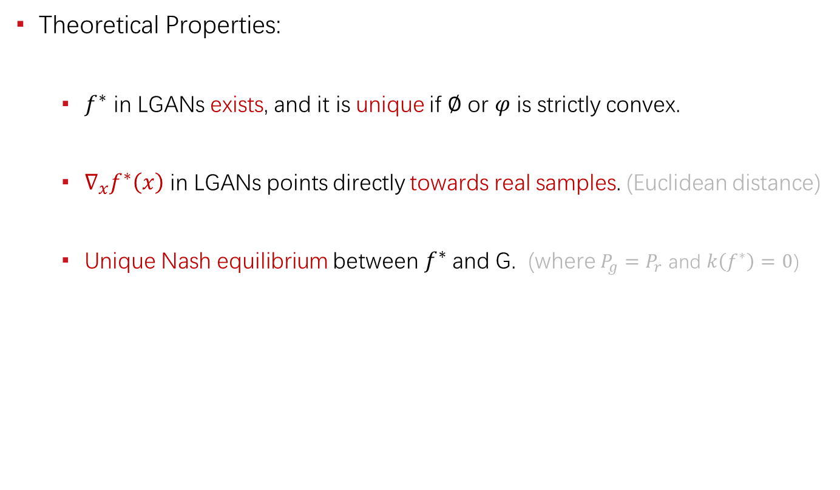
Lipschitz GANs
Theoretical Properties:
  $f^{∗}$ in LGANs exists, and it is unique if $∅$ or $φ$ is strictly convex.
  $∇_{x}f^{∗}\left(x\right)$ in LGANs points directly towards real samples. (Euclidean distance)
  Unique Nash equilibrium between $f^{∗}$ and G. (where $P_{g}=P_{r}$ and $k\left(f^{∗}\right)=0$)

Slide 16
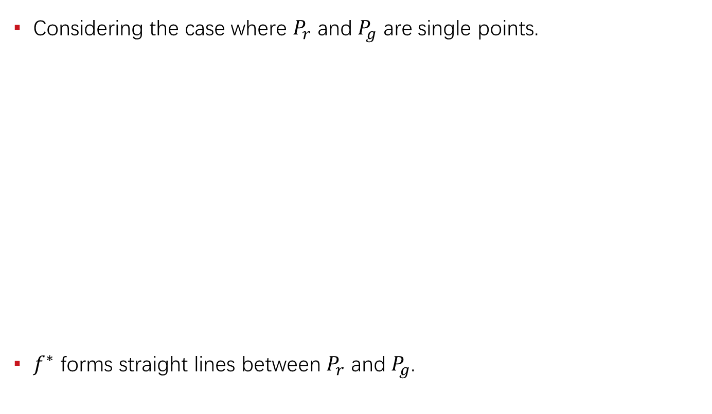




Illustration
Considering the case where $P_{r}$ and $P_{g}$ are single points.
$f^{∗}$ forms straight lines between $P_{r}$ and $P_{g}$.
$$f^{∗}(x)$$
The line in between is well defined, while others are not.
$$P_{r}$$
$$P_{g}$$
$$x$$

Slide 17
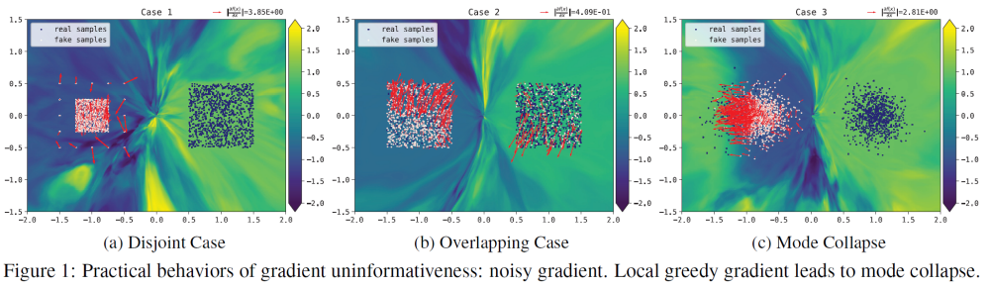
Experiments
Practical behaviors of gradient uninformativeness: (noise)

Slide 18
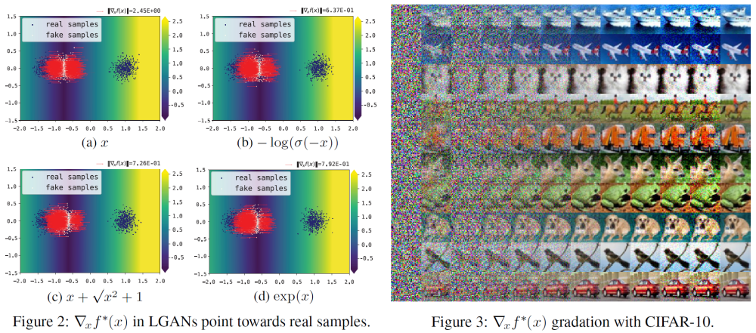
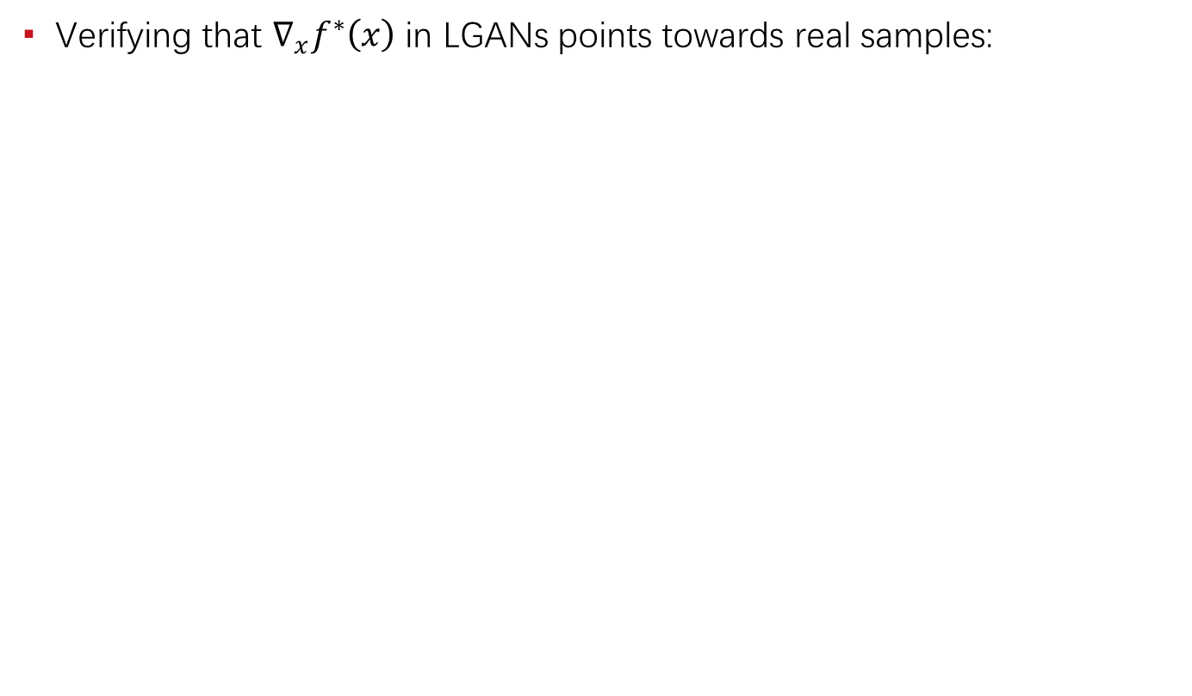
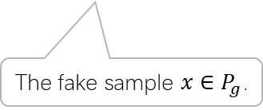
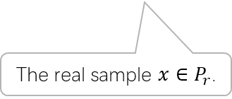

Experiments
Verifying that $∇_{x}f^{∗}\left(x\right)$ in LGANs points towards real samples:
The gradient $∇_{x}f^{∗}\left(x\right)$ and $x+k∙∇_{x}f^{∗}\left(x\right)$.
The fake sample $x∈P_{g}$.
The real sample $x∈P_{r}$.

Slide 19
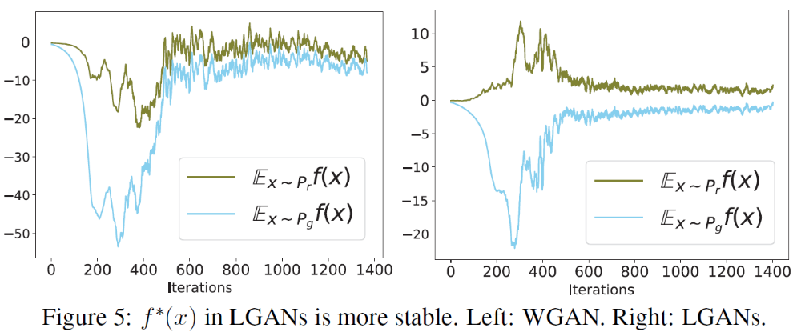

Experiments
The influence of uniqueness of $f^{∗}$: (stabilized)

Slide 20
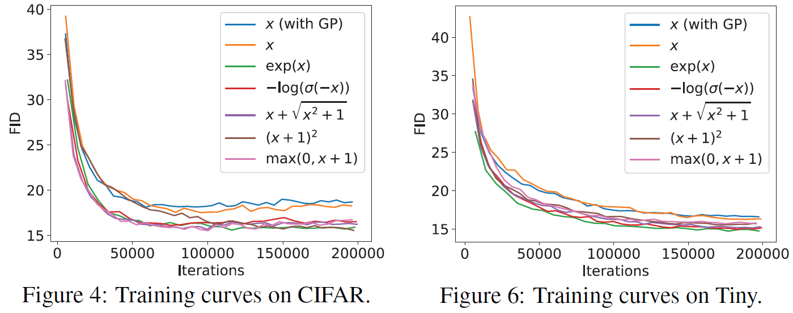
Experiments
Benchmark the LGANs family: (consistently outperform WGANs)

Slide 21
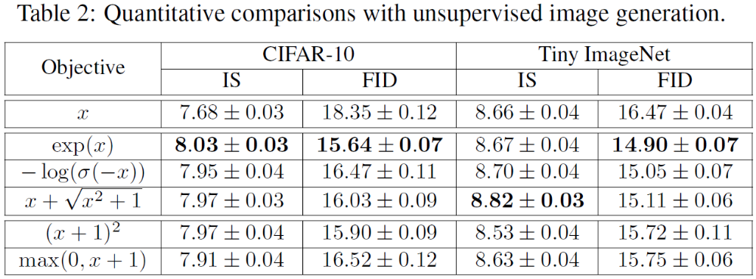
Experiments
Benchmark the LGANs family: (consistently outperform WGANs)

Slide 22
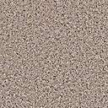
Mode Collapse
Objective level cause: (main)
  Unrestricted GANs (including vanilla GANs)
    Existence of gathering / clustering effect. (local greedy)
    Missing of force to separate clustered samples.
    Existence of local optimum.
  WGANs / LGANs
    No objective level local optimum.
    Existence of force to separate clustered samples. (if not clustered to a single point)
Neural network level cause: (minor)
  Network degeneration. (related to training failure)
  Limited capacity / expressiveness issue.
A local optimum state of some traditional GANs.

Slide 23
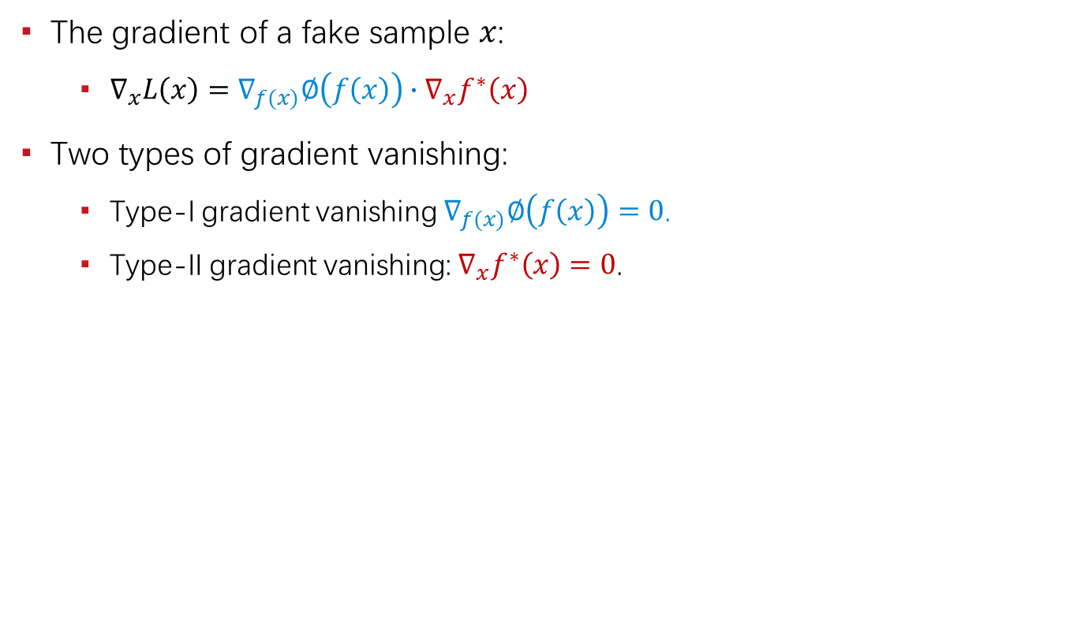
Gradient Vanishing
The gradient of a fake sample $x$:
  $∇_{x}L\left(x\right)=∇_{f(x)}∅\left(f\left(x\right)\right)∙∇_{x}f^{∗}\left(x\right)$
Two types of gradient vanishing:
  Type-I gradient vanishing $∇_{f(x)}∅\left(f\left(x\right)\right)=0$.
  Type-II gradient vanishing: $∇_{x}f^{∗}\left(x\right)=0$.
 | Type-I Gradient Vanishing | Type-II Gradient Vanishing
Vanilla GANs | Yes | Yes
Least-squares GANs | No | Yes
WGANs / LGANs | No | No

Slide 24
Unreachable Optimum
Evidences & Possible Causes

Slide 25
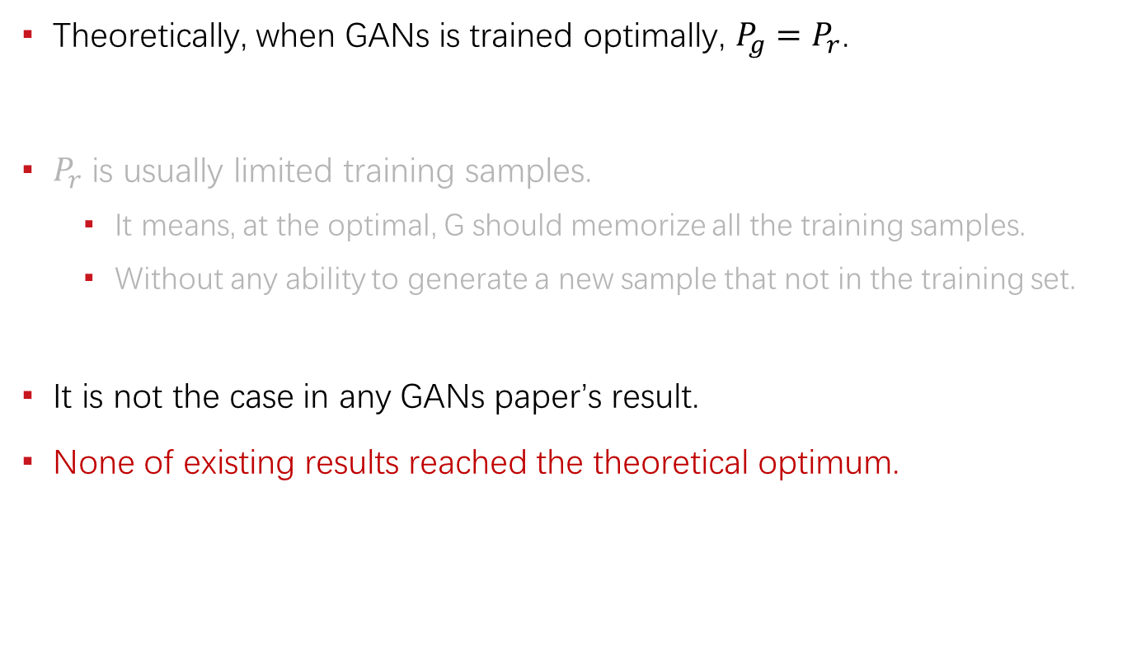
The Evidences
Theoretically, when GANs is trained optimally, $P_{g}=P_{r}$.
$P_{r}$ is usually limited training samples.
  It means, at the optimal, G should memorize all the training samples.
  Without any ability to generate a new sample that not in the training set.
It is not the case in any GANs paper’s result.
None of existing results reached the theoretical optimum.

Slide 26
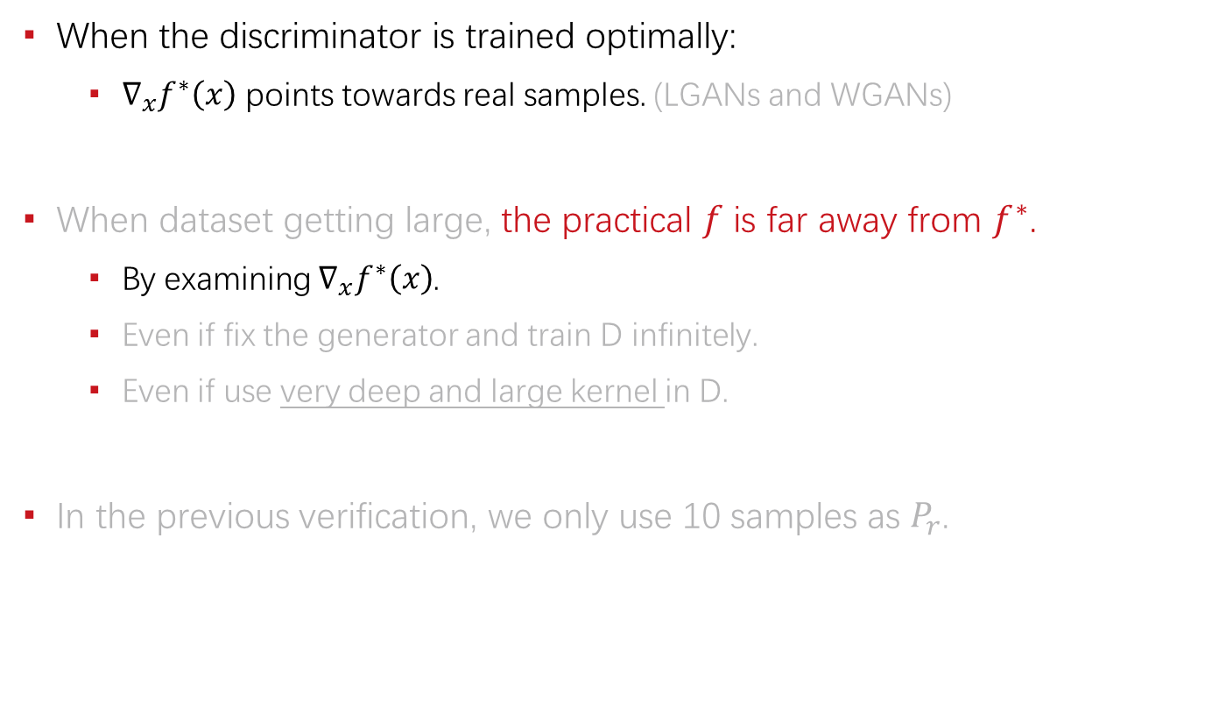
The Evidences
When the discriminator is trained optimally:
  $∇_{x}f^{∗}\left(x\right)$ points towards real samples. (LGANs and WGANs)
When dataset getting large, the practical $f$ is far away from $f^{∗}$.
  By examining $∇_{x}f^{∗}\left(x\right)$.
  Even if fix the generator and train D infinitely.
  Even if use very deep and large kernel in D.
In the previous verification, we only use 10 samples as $P_{r}$.

Slide 27
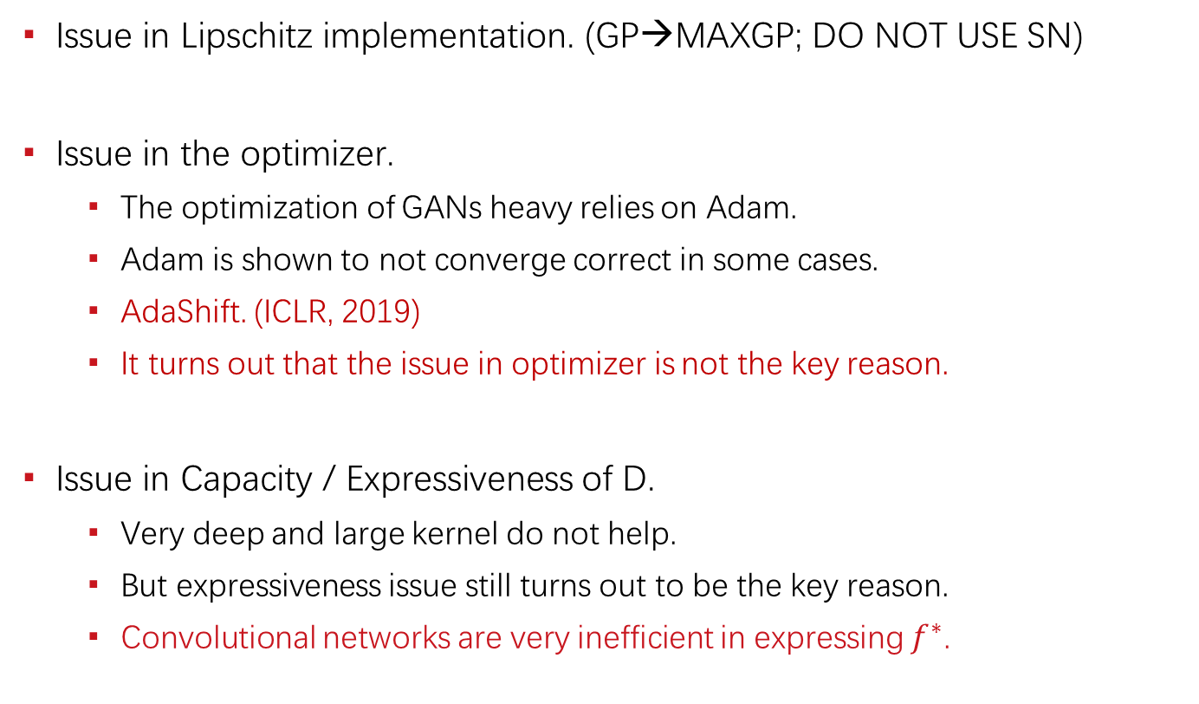
Possible Causes
Issue in Lipschitz implementation. (GP→MAXGP; DO NOT USE SN)
Issue in the optimizer.
  The optimization of GANs heavy relies on Adam.
  Adam is shown to not converge correct in some cases.
  AdaShift. (ICLR, 2019)
  It turns out that the issue in optimizer is not the key reason.
Issue in Capacity / Expressiveness of D.
  Very deep and large kernel do not help.
  But expressiveness issue still turns out to be the key reason.
  Convolutional networks are very inefficient in expressing $f^{∗}$.

Slide 28
The Convergence of Adam
Mainly from Adashift. (ICLR, 2019)

Slide 29
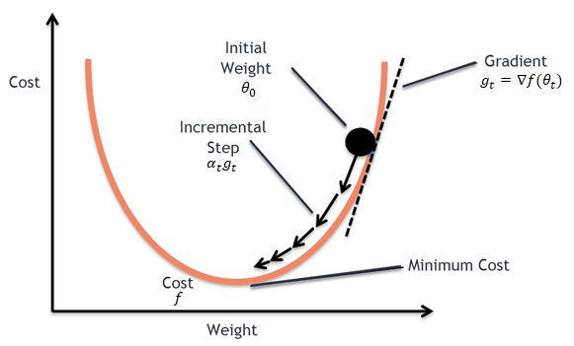

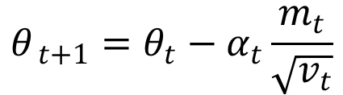





SGD → Adam
SGD:
Momentum*:
Adam:
$$θ_{ t+1}=θ_{t}−α_{t}g_{t}$$
$$θ_{ t+1}=θ_{t}−α_{t}m_{t}$$
$$m_{t}=β_{1}m_{t−1}+(1−β_{1})g_{t}$$
$$θ_{ t+1}=θ_{t}−α_{t}\frac{m_{t}}{\sqrt{v_{t}}}$$
$$v_{t}=β_{2}v_{t−1}+(1−β_{2})g_{t}^{2}$$

Slide 30
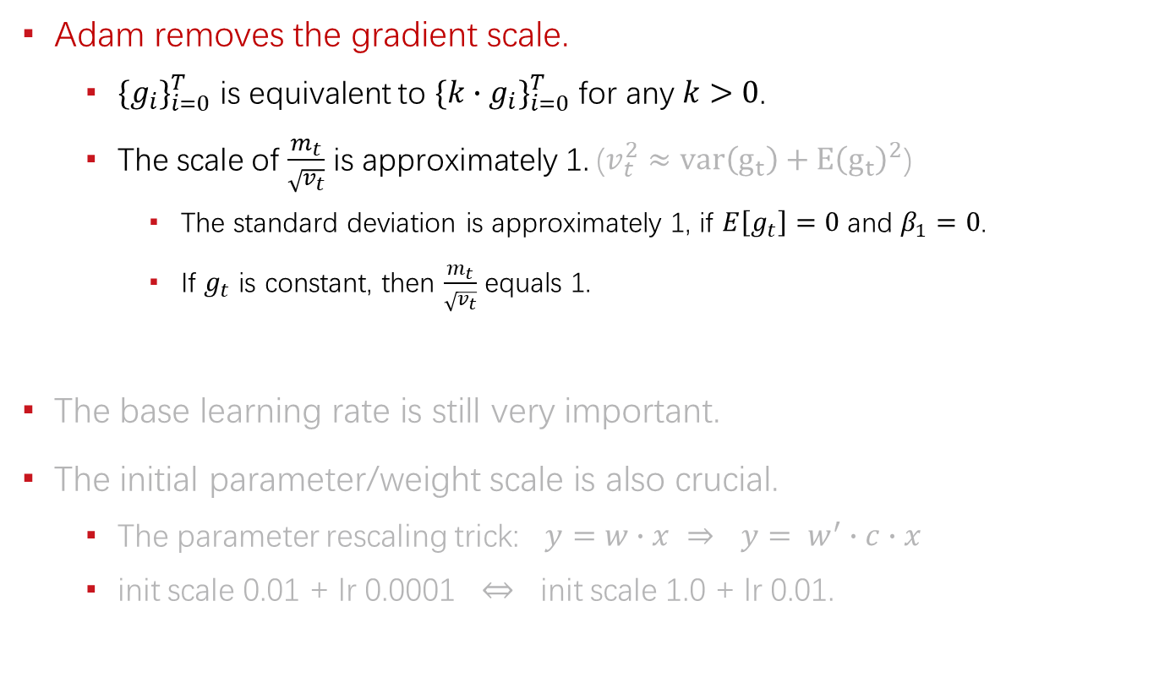
Adam’s properties
Adam removes the gradient scale.
  ${\{g_{i}\}}_{i=0}^{T}$ is equivalent to ${\{k∙g_{i}\}}_{i=0}^{T}$ for any $k>0$.
  The scale of $\frac{m_{t}}{\sqrt{v_{t}}}$ is approximately 1. ($v_{t}^{2}≈var\left(g_{t}\right)+Ε{\left(g_{t}\right)}^{2}$)
    The standard deviation is approximately 1, if $E\left[g_{t}\right]=0$ and $β_{1}=0$.
    If $g_{t}$ is constant, then $\frac{m_{t}}{\sqrt{v_{t}}}$ equals 1.
The base learning rate is still very important.
The initial parameter/weight scale is also crucial.
  The parameter rescaling trick: $y=w∙x$ $⇒$ $y= w^{′}∙c∙x$
  init scale 0.01 + lr 0.0001 $⇔$ init scale 1.0 + lr 0.01.

Slide 31
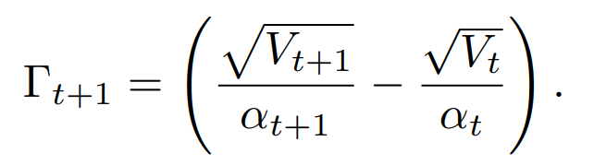
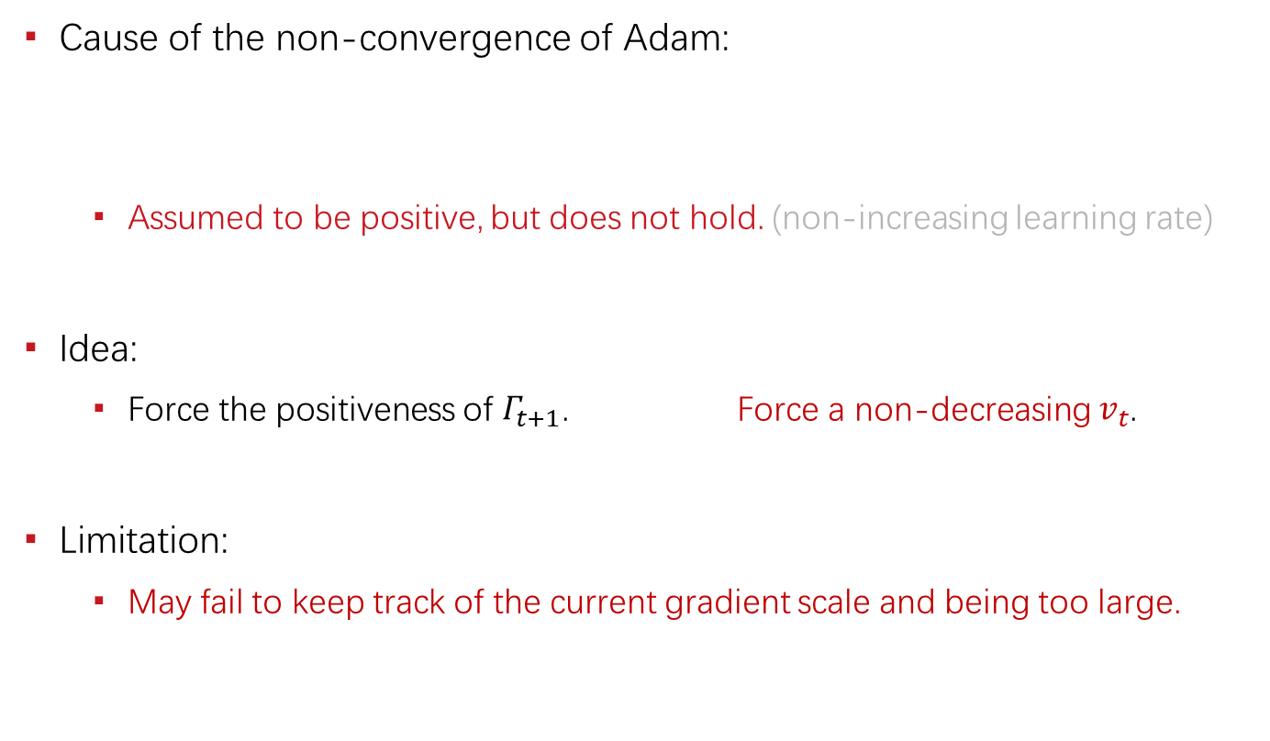
Existing Solution: AMSGrad
Cause of the non-convergence of Adam:
  Assumed to be positive, but does not hold. (non-increasing learning rate)
Idea:
  Force the positiveness of $Γ_{t+1}$. Force a non-decreasing $v_{t}$.
Limitation:
  May fail to keep track of the current gradient scale and being too large.

Slide 32
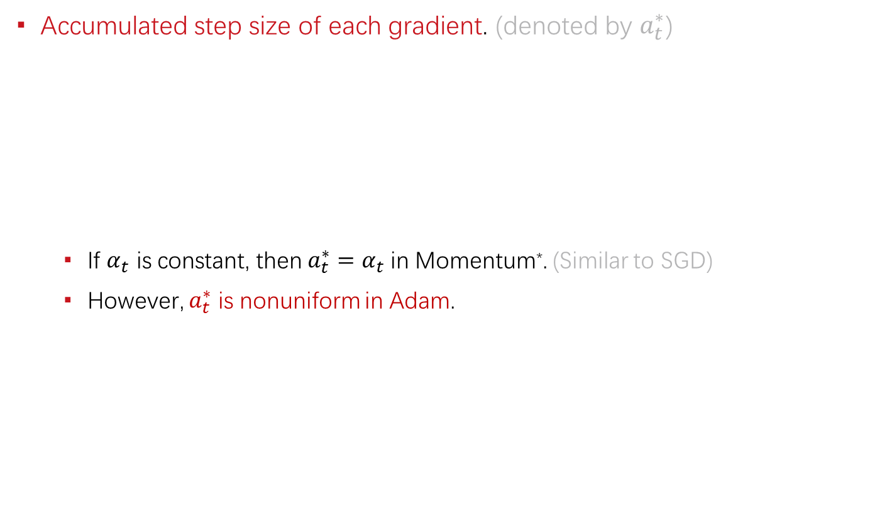
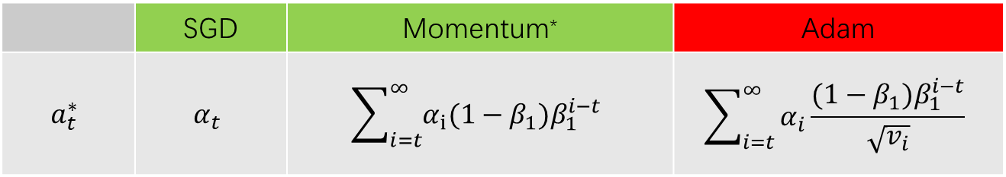
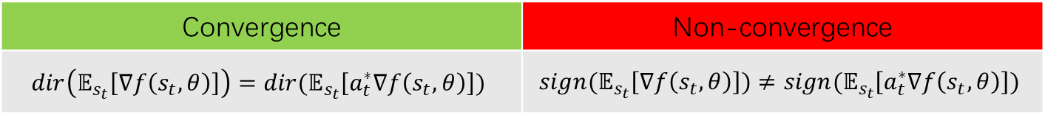

The New Perspective
Accumulated step size of each gradient. (denoted by $a_{t}^{∗}$)
  If $α_{t}$ is constant, then $a_{t}^{∗}=α_{t}$ in Momentum*. (Similar to SGD)
  However, $a_{t}^{∗}$ is nonuniform in Adam.
 | SGD | Momentum* | Adam
$$a_{t}^{∗}$$ | $$α_{t}$$ | $$\sum_{i=t}^{∞}{α_{i}(1−β_{1})β_{1}^{i−t}}$$ | $$\sum_{i=t}^{∞}{α_{i}\frac{(1−β_{1})β_{1}^{i−t}}{\sqrt{v_{i}}}}$$
Convergence | Non-convergence
$$dir\left(𝔼_{s_{t}}\left[∇f\left(s_{t},θ\right)\right]\right)=dir(𝔼_{s_{t}}\left[a_{t}^{∗}∇f\left(s_{t}, θ\right)\right])$$ | $$sign(𝔼_{s_{t}}\left[∇f\left(s_{t}, θ\right)\right])≠sign(𝔼_{s_{t}}\left[a_{t}^{∗}∇f\left(s_{t}, θ\right)\right])$$
$s_{t}$is sample or mini-batch.

Slide 33
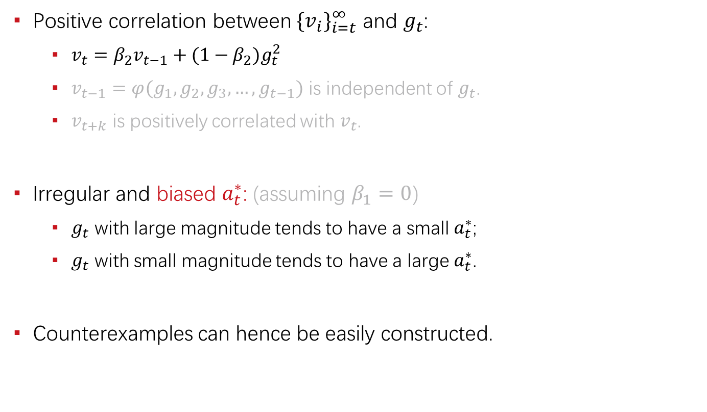

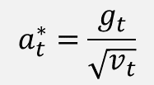
Non-convergence of Adam
Positive correlation between ${{\{v}_{i}\}}_{i=t}^{∞}$ and $g_{t}$:
  $v_{t}=β_{2}v_{t−1}+(1−β_{2})g_{t}^{2}$
  $v_{t−1}=φ(g_{1},g_{2},g_{3},…,g_{t−1})$ is independent of $g_{t}$.
  $v_{t+k}$ is positively correlated with $v_{t}$.
Irregular and biased $a_{t}^{∗}$: (assuming $β_{1}=0$)
  $g_{t}$ with large magnitude tends to have a small $a_{t}^{∗}$;
  $g_{t}$ with small magnitude tends to have a large $a_{t}^{∗}$.
Counterexamples can hence be easily constructed.
$$a_{t}^{∗}=\frac{g_{t}}{\sqrt{v_{t}}}$$
$$a_{t}^{∗}=\sum_{i=t}^{∞}{α_{i}\frac{(1−β_{1})β_{1}^{i−t}}{\sqrt{v_{i}}}}$$

Slide 34
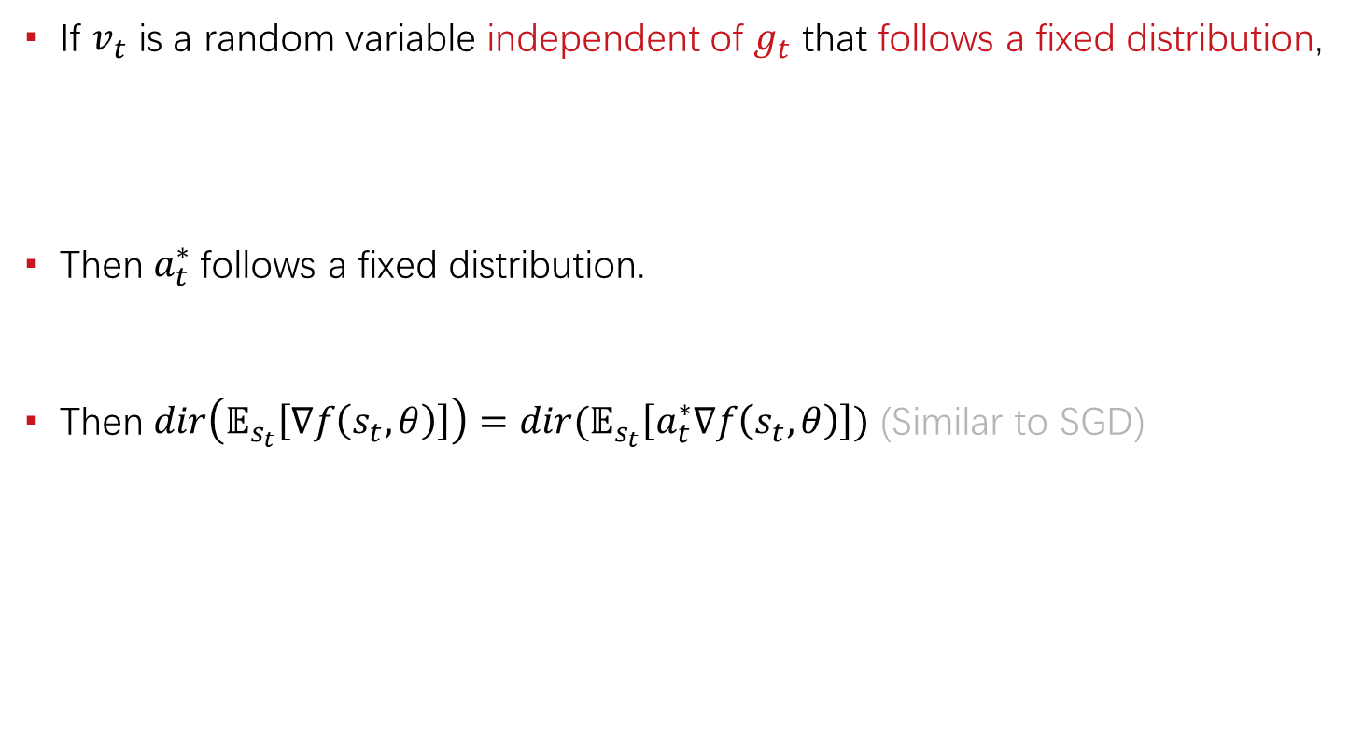
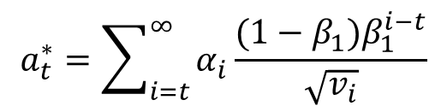
Towards Convergence
If $v_{t}$ is a random variable independent of $g_{t}$ that follows a fixed distribution,
Then $a_{t}^{∗}$follows a fixed distribution.
Then $dir\left(𝔼_{s_{t}}\left[∇f\left(s_{t}, θ\right)\right]\right)=dir(𝔼_{s_{t}}\left[a_{t}^{∗}∇f\left(s_{t}, θ\right)\right])$ (Similar to SGD)
$$a_{t}^{∗}=\sum_{i=t}^{∞}{α_{i}\frac{(1−β_{1})β_{1}^{i−t}}{\sqrt{v_{i}}}}$$

Slide 35
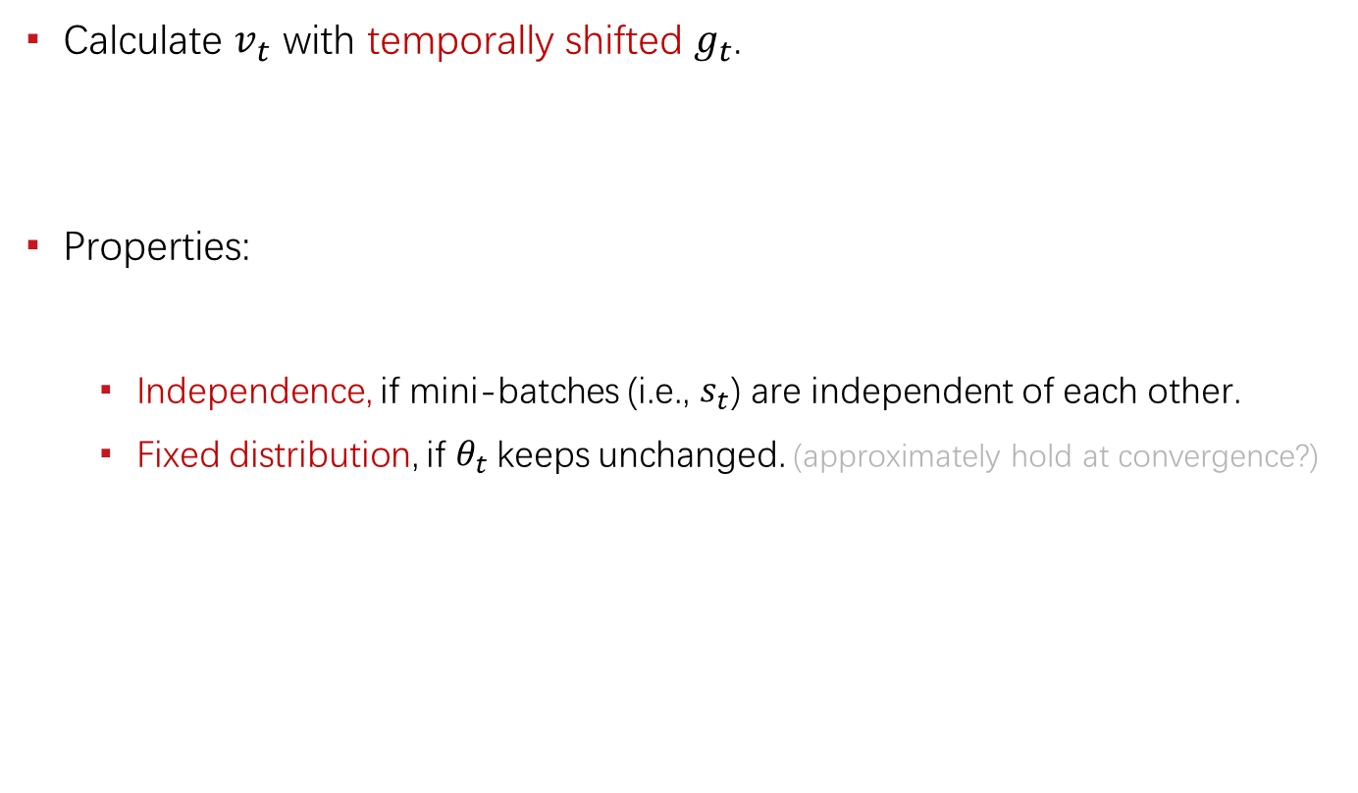


AdaShift: Core Idea
Calculate $v_{t}$ with temporally shifted $g_{t}$.
Properties:
  Independence, if mini-batches (i.e., $s_{t}$) are independent of each other.
  Fixed distribution, if $θ_{t}$keeps unchanged. (approximately hold at convergence?)
$$v_{t}=β_{2}v_{t−1}+(1−β_{2})g_{t−1}^{2}$$
  $$g_{t}=∇f(s_{t};θ_{t})$$

Slide 36
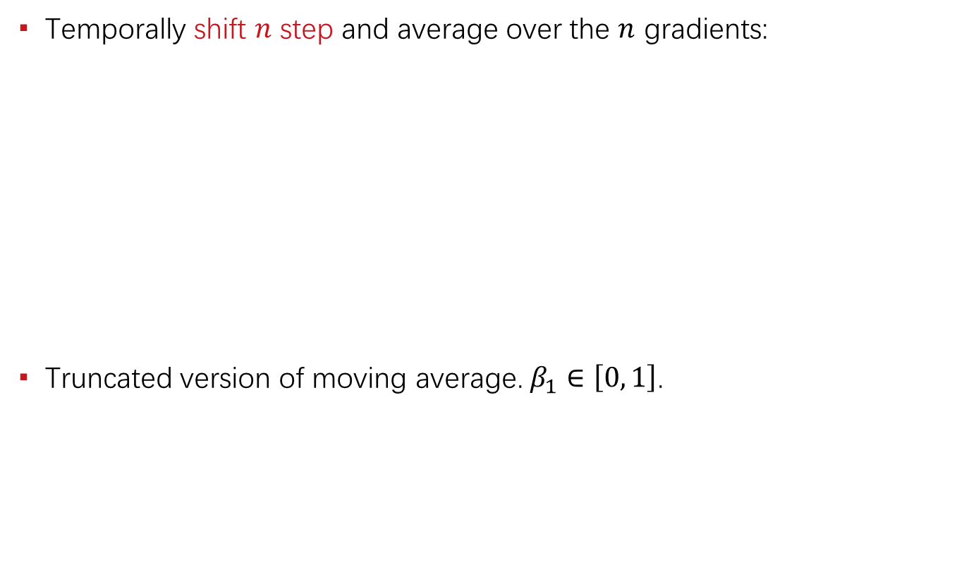
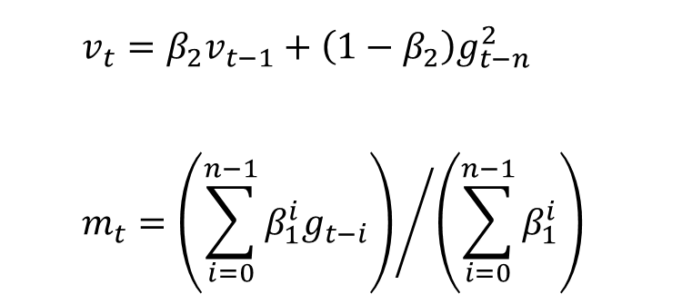
AdaShift: First Moment
Temporally shift $n$ step and average over the $n$ gradients:
Truncated version of moving average. $β_{1}∈\left[0, 1\right]$.
  $$v_{t}=β_{2}v_{t−1}+\left(1−β_{2}\right)g_{t−n}^{2}$$
  $$m_{t}={\left(\sum_{i=0}^{n−1}{β_{1}^{i}g_{t−i}}\right)}/{\left(\sum_{i=0}^{n−1}{β_{1}^{i}}\right)}$$

Slide 37
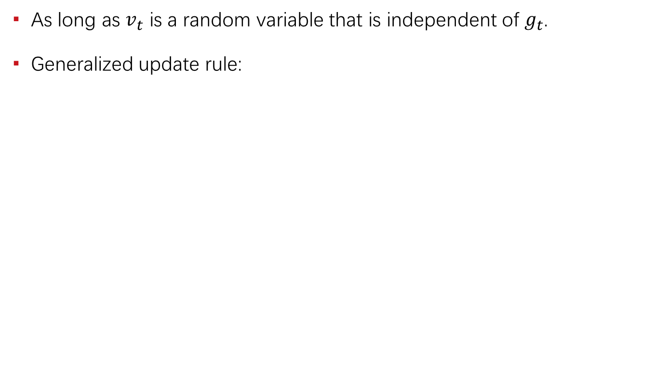




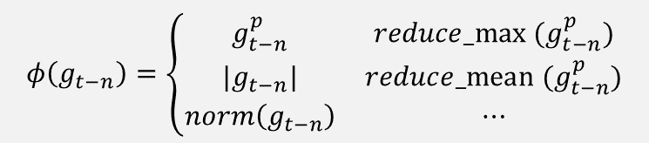
AdaShift: Generalize $v_{t}$
As long as $v_{t}$ is a random variable that is independent of $g_{t}$.
Generalized update rule:
$$v_{t}=β_{2}v_{t−1}+\left(1−β_{2}\right)g_{t−n}^{2}$$
$$φ\left(g_{t−n}\right)=\left\{\begin{matrix}g_{t−n}^{p} & reduce_max (g_{t−n}^{p}) \\ |g_{t−n}| & reduce_mean (g_{t−n}^{p}) \\ norm\left(g_{t−n}\right) & ⋯\end{matrix}\right.$$
$v_{t}=β_{2}v_{t−1}+(1−β_{2})φ(g_{t−n})$
$v_{t}=φ(v_{t−1}, g_{t−n})$
$φ\left(v_{t−1}, g_{t−n}\right)=max \left(β_{2}v_{t−1}, norm\left(g_{t−n}\right)\right)$

Slide 38
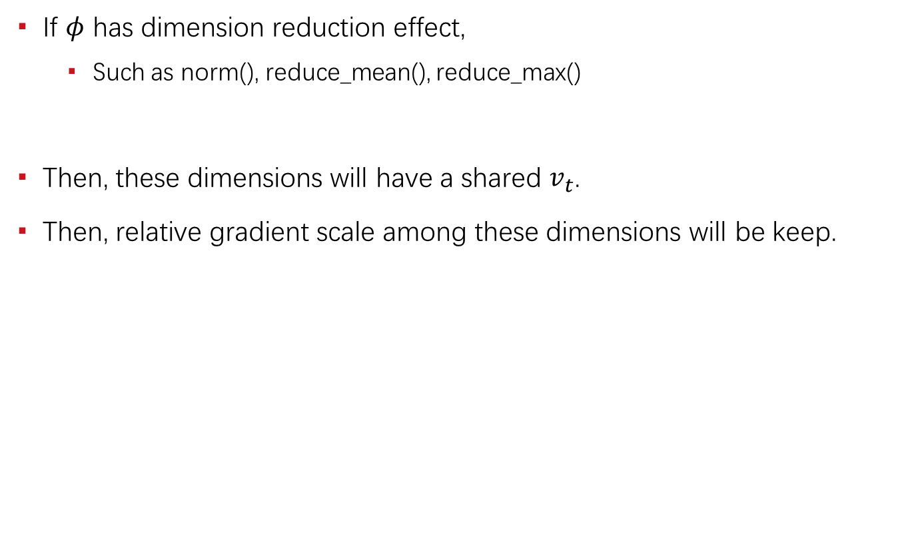

AdaShift: Share $v_{t}$ → adaptive SGD
If $φ$ has dimension reduction effect,
  Such as norm(), reduce_mean(), reduce_max()
Then, these dimensions will have a shared $v_{t}$.
Then, relative gradient scale among these dimensions will be keep.
Adam | remove gradient scale | Keep the gradient signs.
SGD | keep gradient scale | Keep the gradient direction.
AdaShift | remove the global scale, but keep the relative scale | Keep the gradient direction.

Slide 39

Experiments
Counterexamples: (converge as expected)

Slide 40

Experiments
Benchmarks: competitive with Adam

Slide 41

Experiments
Benchmarks: competitive with Adam

Slide 42

AdaShift++
New feature:
  Totally removed the extra memory cost for storing past gradients.
Perfection:
  Extensive study of generalized $v_{t}$ and trying to find better variants.
  Convergence rate, etc.

Slide 43
Sample Quality Issue
AM-GANs. (ICLR, 2018)

Slide 44
Background
Low sample quality when GANs is trained on complex dataset.
Label information can significantly improve the sample quality.
However,
  Existing works lack of theoretical justification.
  How class labels interact with GANs is not fully understood.

Slide 45

Limitation of AC-GANs
Adversary training is missing in the auxiliary classifier.
Maximum activation of class logit is not guaranteed to be good sample.
  Train an auxiliary classifier.
  G maximizes samples’ activation on class logits.
Odena et al. 2017

Slide 46



How LabelGANs Works
Class-aware gradient:
The gradient is distributed to logit $l_{k}\left(x\right)$ according to $\frac{D_{k}(x)}{D_{r}(x)}$.
The gradient tends to refine each sample towards one of the classes.
Salimans et al. 2016

Slide 47

Limitation of LabelGANs
The gradient signal is not clear enough.
It encourages all real classes at the same time.

Slide 48

AM-GANs
Specific target class for each sample. (based on LabelGANs)
  Each valid sample must belong to one of the classes.
  Clearer gradient information.
Dynamic labeling. (substitute label conditioning, i.e., predefined label)
  Generator remains unconditional.

Slide 49
Relationships
Cross entropy decomposition:
AC-GANs = AC + GANs
AM-GANs = AC + LabelGANs

Slide 50

Experiments
(1) AM-GANs outperforms all baselines.
(2) AC-GANs with extra adversarial training outperform AC-GANs.
(3) Dynamic labeling outperforms label conditioning.

Slide 51
AM-GANs Extensions

Slide 52
Understanding Unrestricted GANs
AM-GANs is one of the unrestricted GANs.
  A multi-class generalization of vanilla GANs. (with –log D(x) trick)
  It does not guarantee its convergence.
The adversarial activation maximization perspective:
  In contrast to the divergence perspective.
  It helps understand how to make the non-guaranteed training work.

Slide 53


Evaluation Metrics
Inception Score does not work as commonly understood.
Inception Score has some ability to detect mode collapse.
AM-Score proposed to better measure the sample quality.

Slide 54
WGANs / LGANs with labels
WGANs / LGANs have sample level target for each point.
Class label can also be introduced to improve WGANs / LGANs.
  Not an extra classifier. (missing of adversarial training)
  The correct direction: define class level transport.
  It can be achieved with implementation tricks.

Slide 55
Reference
[1] Zhou, Zhiming, Jiadong Liang, Yuxuan Song, Lantao Yu, Hongwei Wang, Weinan Zhang, Yong Yu, and Zhihua Zhang. "Lipschitz Generative Adversarial Nets." In International Conference on Machine Learning (ICML), 2019.
[2] Zhou, Zhiming*, Qingru Zhang*, Guansong Lu, Hongwei Wang, Weinan Zhang, and Yong Yu. "AdaShift: Decorrelation and Convergence of Adaptive Learning Rate Methods." In International Conference on Learning Representations (ICLR), 2019.
[3] Zhou, Zhiming, Han Cai, Shu Rong, Yuxuan Song, Kan Ren, Weinan Zhang, Jun Wang, and Yong Yu. "Activation Maximization Generative Adversarial Nets." In International Conference on Learning Representations (ICLR), 2018.
https://scholar.google.com/citations?user=b8YJ1EMAAAAJ&hl=en

Slide 56
谢 谢！

Slide 57










From Momentum to Momentum*
Momentum:
Momentum*:
Rewrite $m_{t}^{∗}$and $m_{t}$ in summation of series:
We have that Momentum is equivalent to Momentum* with
$$θ_{ t+1}=θ_{t}−m_{t}^{∗}$$
with
$$m_{t}^{∗}=β_{1}m_{t−1}^{∗}+α^{∗}g_{t}$$
$$θ_{ t+1}=θ_{t}−{αm}_{t}$$
with
$$m_{t}=β_{1}m_{t−1}+(1−β_{1})g_{t}$$
$$m_{t}^{∗}=\sum_{i=1}^{t}{{a^{∗}β}_{1}^{t−i}g_{i}}$$
$$m_{t}=\sum_{i=1}^{t}{{(1−β_{1})β}_{1}^{t−i}g_{i}}$$
$$α=\frac{α^{∗}}{1−β_{1}}$$
$$m_{t}=\frac{1−β_{1}}{α^{∗}}m_{t}^{∗}$$
and
It is worth noticing the change of equivalent learning rate and $α>α^{∗}$.

Slide 58
More
OT-CycleGANs
Large Scale OT with Cycle Extension
Diverse Colorization
Sparse SVBRDF Acquisition

